Slide 1
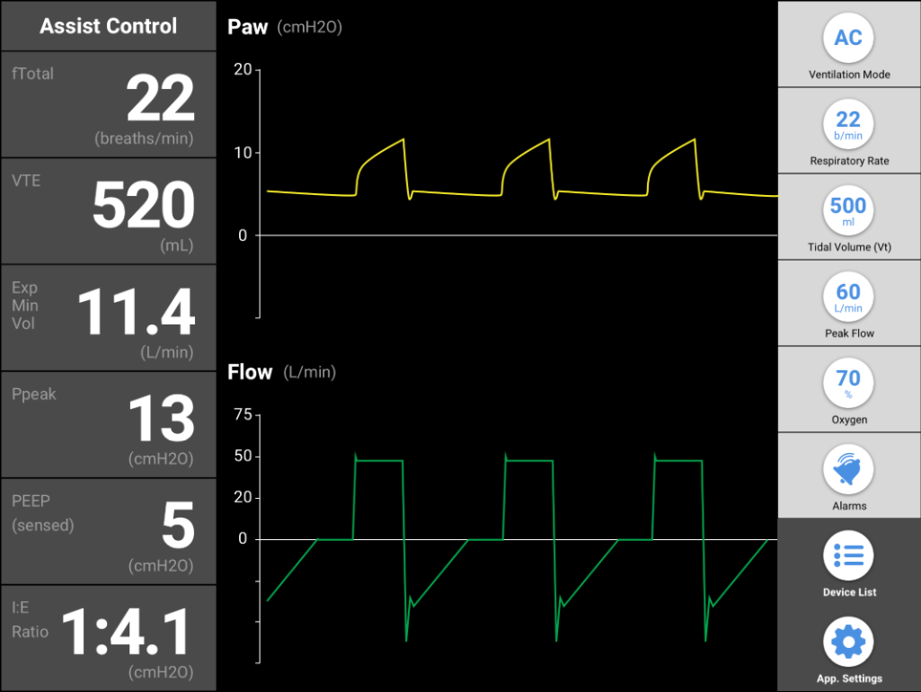






Software Design
Cross Platform Hybrid App
1
Compatiblie with every smartphone and tablet,
both android and iOS
Responsive Mobile First Design
2
Fits the need of every screen. For example, smartphone use will be analogous to remote control, and tablet will function as a full size ventilator control panel.
Wireless Remote Control
3
Securly control your ventilator machine from from the next room.
4
Centralization
4
Manage few ventilator simoultanously in a safe matter
For Clinician From Clinician
5
The user-expirience was developed in collaboration with ICU clinical staff to best suit their need
Notes:
This is the mockup for the main control panel. I need to know that every input and output In the mockup is exist at the hardware end.
Remarks:
Every value that can be calculated from raw inputs will be better calculated at the phone/tablet. They have strong proccesors and its better to do this at the client side. For example, you can calculated “sensed PEEP” at the user phone out of the yellow pressure graph.
The oxygen button is “dumb”, its only gives you what value you need to adjust at the oxygen tap manualy. No hardware meaning.
The alarams we want is detailed here:
http://www.livingwithavent.com/ventilation-basics/ventilator-alarms.html

Slide 2
Notes:
Mobile flow:
First connection is through QR code scan, manualy input or list of devices I already connected at the past.
The next screen is setting up the ventilating properties. First you pich the ventilating mode, after that the app guides you throght the relevant values according to the mode.

Slide 3
Notes:
Mobile flow (cont.):
First control screen is the sensed values.
By swiping left you can change the graphs with the control buttons. Indication for the control button on the right will be with animation when the page first loads.
The upper component with the stats values stays on screen all time.
Same controls and stats as the mockup in the first slids

Slide 4
Notes:
Same rational and flow like mobile. Different composition.

Slide 5
Notes:
Same rational and flow like mobile. Different composition.

Slide 6
Notes:
Same rational and flow like mobile. Different composition.

Slide 7
Notes:
This is the mockup for the main control panel. I need to know that every input and output In the mockup is exist at the hardware end.
Remarks:
Every value that can be calculated from raw inputs will be better calculated at the phone/tablet. They have strong proccesors and its better to do this at the client side. For example, you can calculated “sensed PEEP” at the user phone out of the yellow pressure graph.
The oxygen button is “dumb”, its only gives you what value you need to adjust at the oxygen tap manualy. No hardware meaning.
The alarams we want is detailed here:
http://www.livingwithavent.com/ventilation-basics/ventilator-alarms.html

